Slide 1

MGM’s College of Engineering, Nanded
Department of Computer Science and Engineering
Project
Topic : Bloom Skin
Presented by:
Miss. Talat Siddiqui
Miss. Rasika Rakhewar
Miss. Prajakta Waghmare
Class B.Tech CSE - A
Guided by :
Dr. M. Y. Joshi

Slide 2
Introduction
Skin conditions are among the most common health concerns worldwide, yet access to timely and affordable dermatological care remains limited. BloomSkin is designed to bridge this gap by using AI to instantly analyze skin conditions from a simple smartphone photo and deliver personalized care recommendations—making skincare smarter, faster, and accessible to all.

Slide 3

Technology Stack
Frontend:
React.js: For building a dynamic and component-based user interface.
HTML5 & CSS3: For structure and modern styling.
Backend:
Node.js: For the JavaScript runtime environment.
Express.js: As the web application framework for creating robust APIs.
Database:
MongoDB: A NoSQL database for flexible and scalable data storage.
AI / Machine Learning:
Python: The primary language for ML.
TensorFlow & Keras: For building and running the deep learning model.
MobileNetV2: The pre-trained model architecture used for image classification.

Slide 4
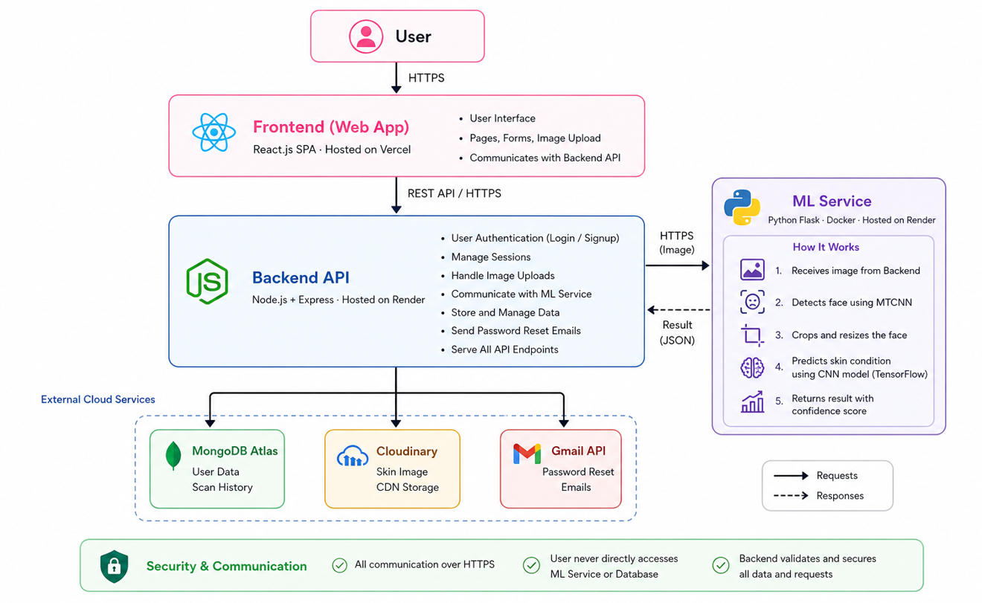
System Architecture
4

Slide 5
Methodology
01
Requirement Analysis
02
System Design & Architecture
We followed an agile-inspired methodology, breaking the project into manageable phases. The process began with detailed requirement analysis and system design. Development was split into backend API creation, AI model wrapping, and frontend component construction. This iterative approach allowed for continuous integration and testing, ensuring each part worked correctly before being combined. Finally, the application was deployed for review and feedback.
03
Agile Development Sprints
04
Model Integration
05
Testing & Debugging
06
Deployment & Review

Slide 6
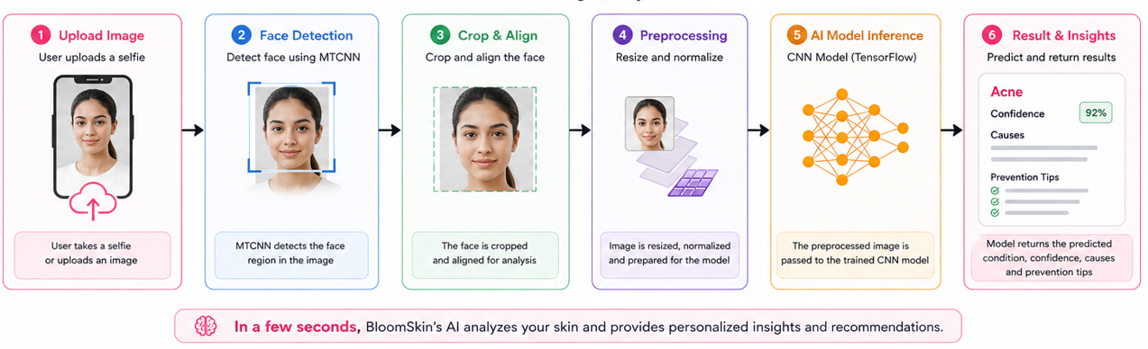
AI Pipeline

Slide 7
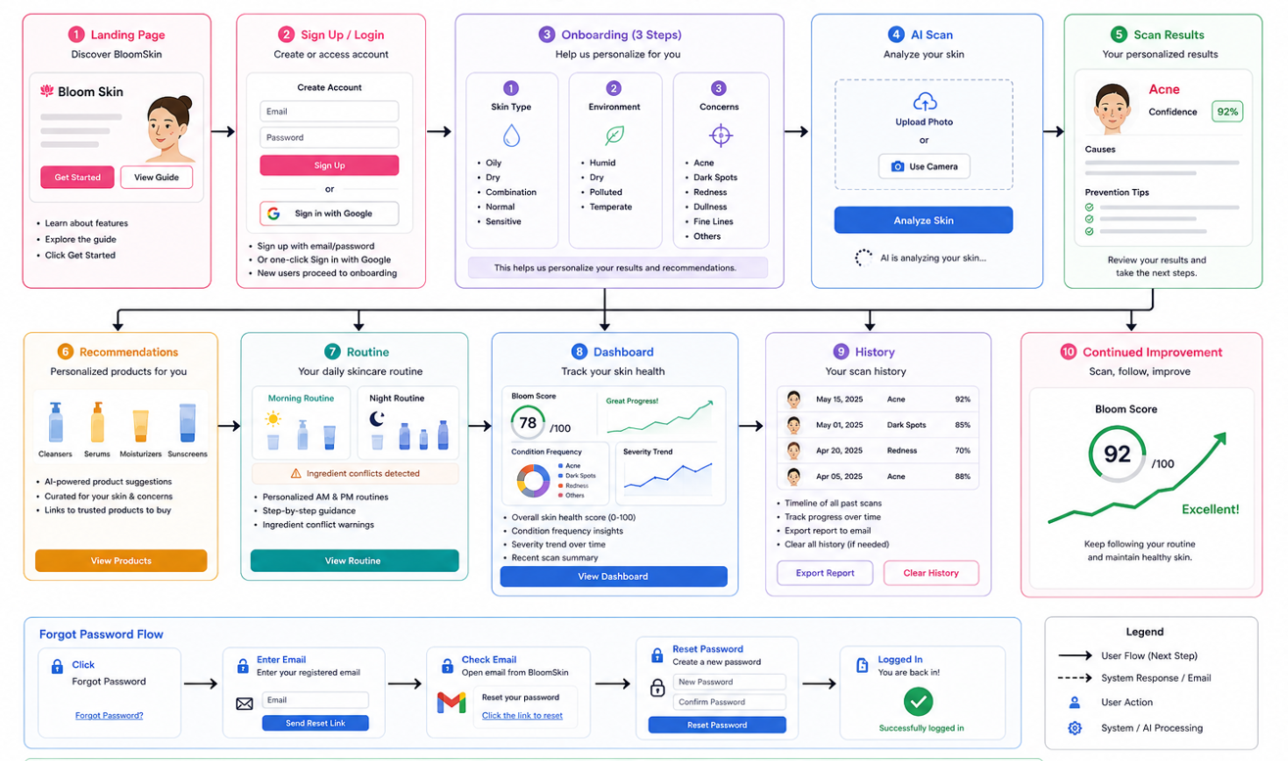
User Flow

Slide 8
Thank You !

